Slide 1
Machine Learning

Slide 2
Content
Generalization
Inductive learning
Decision trees

Slide 3
Generalization
The ultimate goal is to do as well as possible on new, unseen data (a test set), but we only have access to labels (“ground truth”) for the training set
What makes generalization possible?
Inductive bias: set of assumptions a learner uses to predict the target value for previously unseen inputs
This is the same as modeling or choosing a target hypothesis class
Types of inductive bias
Occam’s razor
Similarity/continuity bias: similar inputs should have similar outputs
…

Slide 4
Achieving good generalization
Consideration 1: Bias
How well does your model fit the observed data?
It may be a good idea to accept some fitting error, because it may be due to noise or other “accidental” characteristics of one particular training set
Consideration 2: Variance
How robust is the model to the selection of a particular training set?
To put it differently, if we learn models on two different training sets, how consistent will the models be?

Slide 5
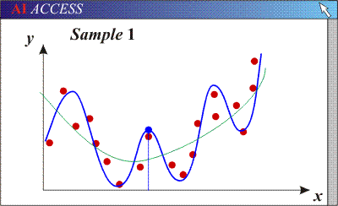
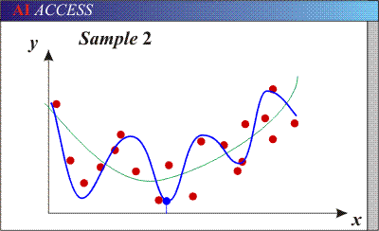
Bias/variance tradeoff
Models with too many parameters may fit the training data well (low bias), but are sensitive to choice of training set (high variance)

Slide 6
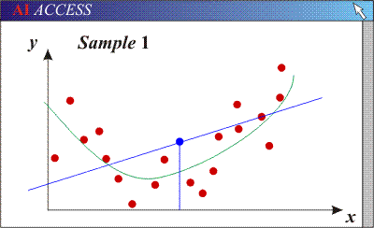
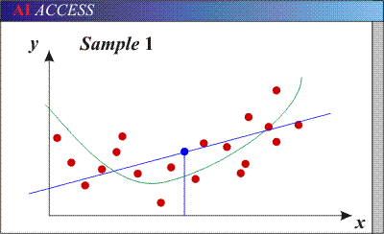
Bias/variance tradeoff
Models with too many parameters may fit the training data well (low bias), but are sensitive to choice of training set (high variance)
Models with too few parameters may not fit the data well (high bias) but are consistent across different training sets (low variance)
2

Slide 7
Inductive Learning
Inductive learning or “Prediction”:
Given examples of a function (X, F(X))
Predict function F(X) for new examples X
Classification
F(X) = Discrete
Regression
F(X) = Continuous
Probability estimation
F(X) = Probability(X):

Slide 8
Terminology
Feature Space:
Properties that describe the problem
0.0 1.0 2.0 3.0
0.0 1.0 2.0 3.0 4.0 5.0 6.0

Slide 9
Terminology
Example:
<0.5,2.8,+>
0.0 1.0 2.0 3.0
+
+
+
+
-
+
+
-
-
-
-
+
+
-
-
+
-
-
+
-
-
+
+
+
-
-
0.0 1.0 2.0 3.0 4.0 5.0 6.0

Slide 10
Terminology
Hypothesis:
Function for labeling examples
0.0 1.0 2.0 3.0
+
+
Label: +
+
Label: -
?
+
-
+
+
-
-
-
-
+
+
-
?
?
-
+
-
-
+
-
-
+
+
+
-
?
-
0.0 1.0 2.0 3.0 4.0 5.0 6.0

Slide 11
Terminology
Hypothesis Space:
Set of legal hypotheses
0.0 1.0 2.0 3.0
+
+
+
+
-
+
+
-
-
-
-
+
+
-
-
+
-
-
+
-
-
+
+
+
-
-
0.0 1.0 2.0 3.0 4.0 5.0 6.0

Slide 12
Supervised Learning
Given: <x, f(x)> for some unknown function f
Learn: A hypothesis H, that approximates f
Example Applications:
Disease diagnosis
x: Properties of patient (e.g., symptoms, lab test results) f(x): Predict disease
Automated steering
x: Bitmap picture of road in front of car
f(x): Degrees to turn the steering wheel
Credit risk assessment
x: Customer credit history and proposed purchase
f(x): Approve purchase or not

Slide 13
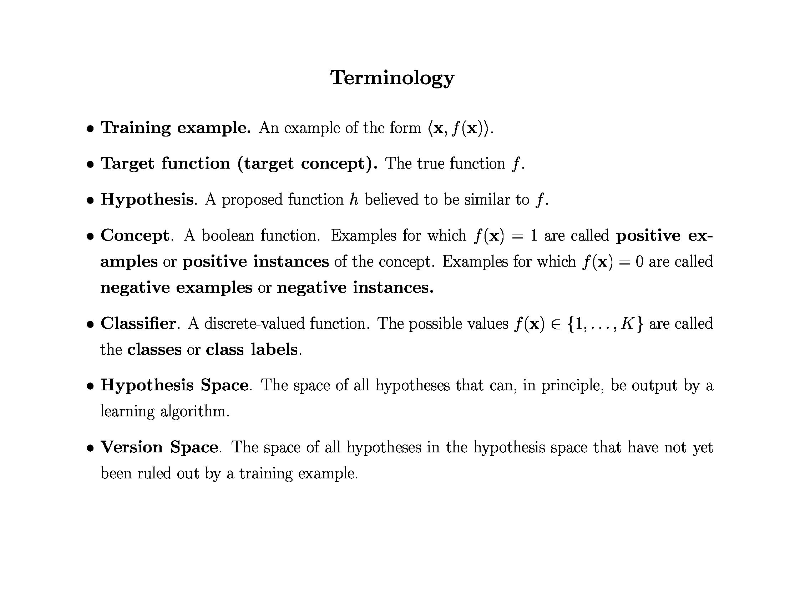

Slide 14
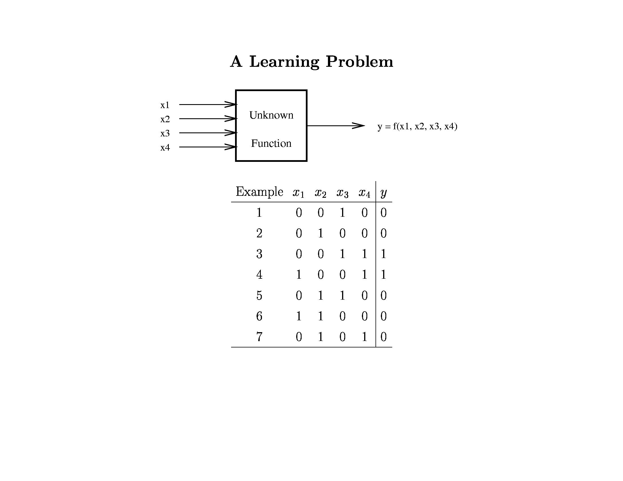

Slide 15
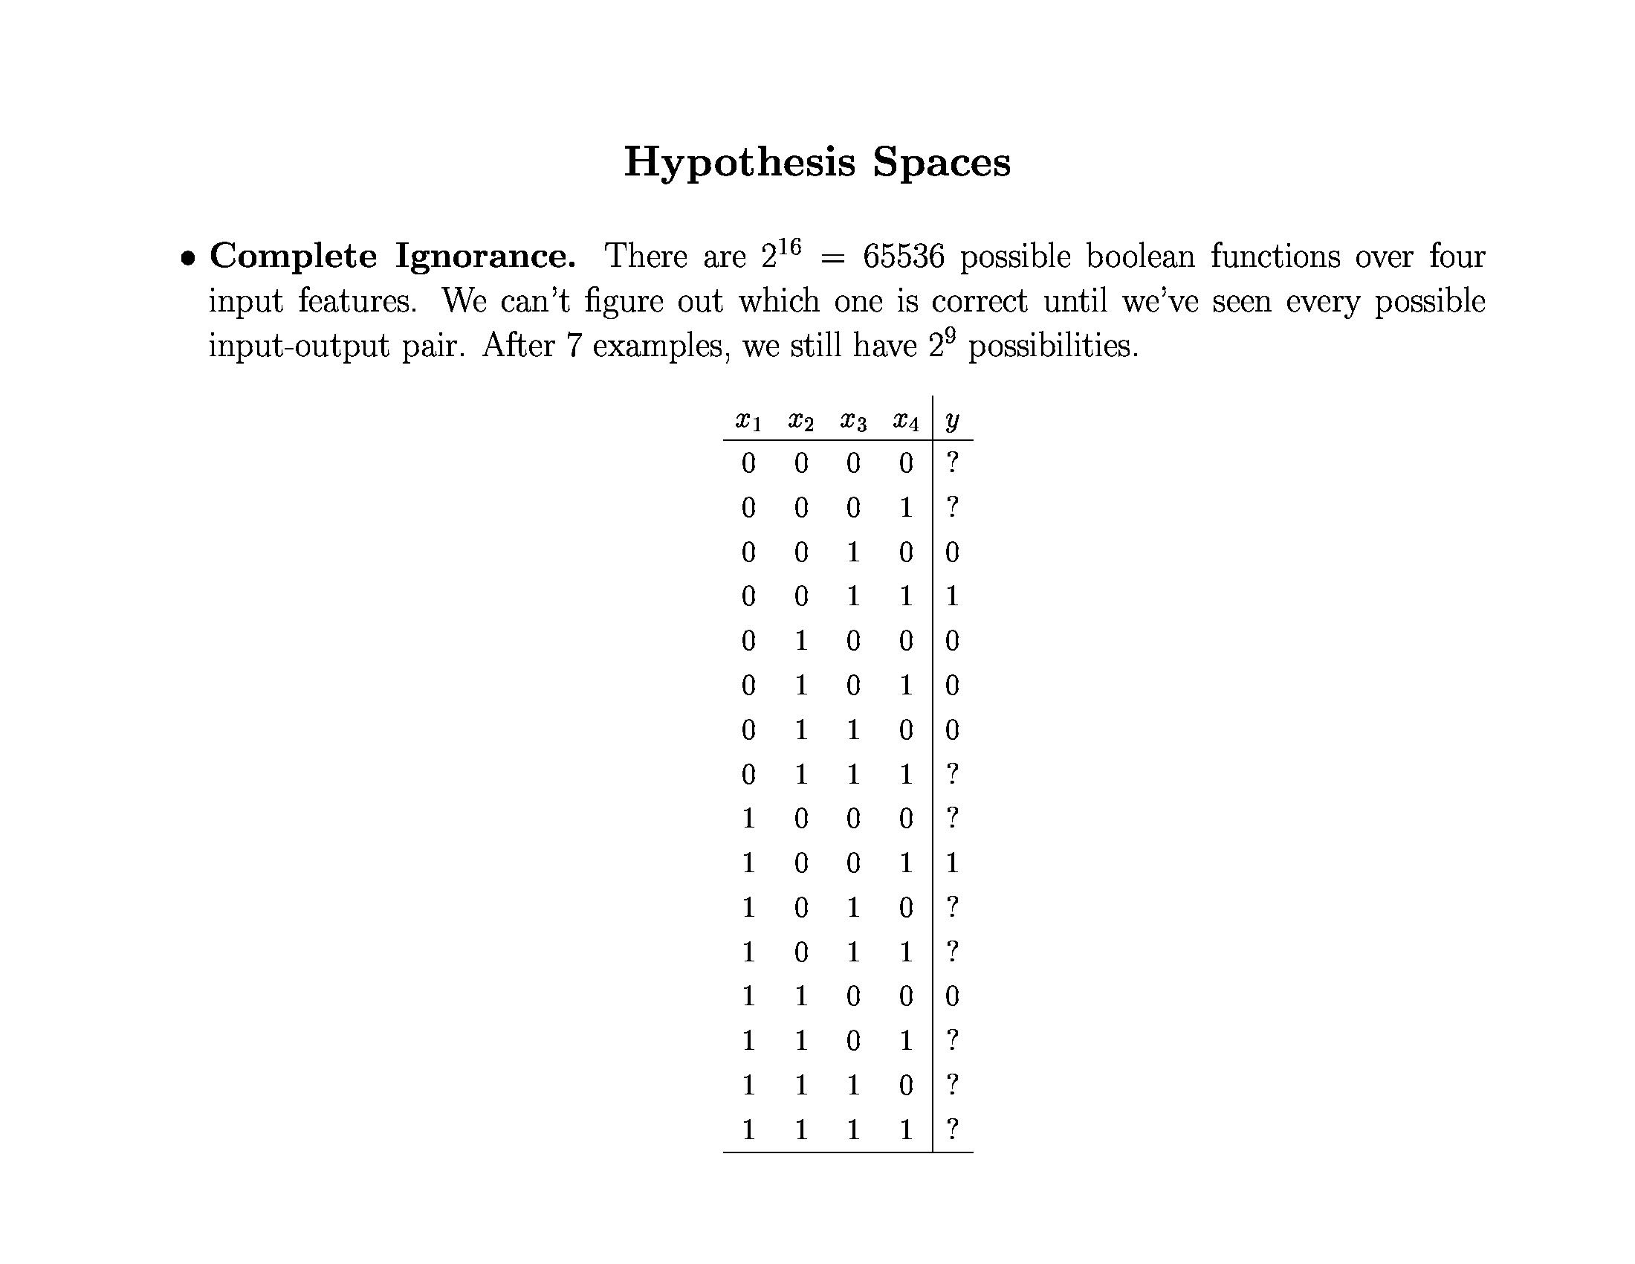

Slide 16
Inductive Bias
Need to make assumptions
Experience alone doesn’t allow us to make conclusions about unseen data instances
Two types of bias:
Restriction: Limit the hypothesis space (e.g., look at rules)
Preference: Impose ordering on hypothesis space (e.g., more general, consistent with data)

Slide 17
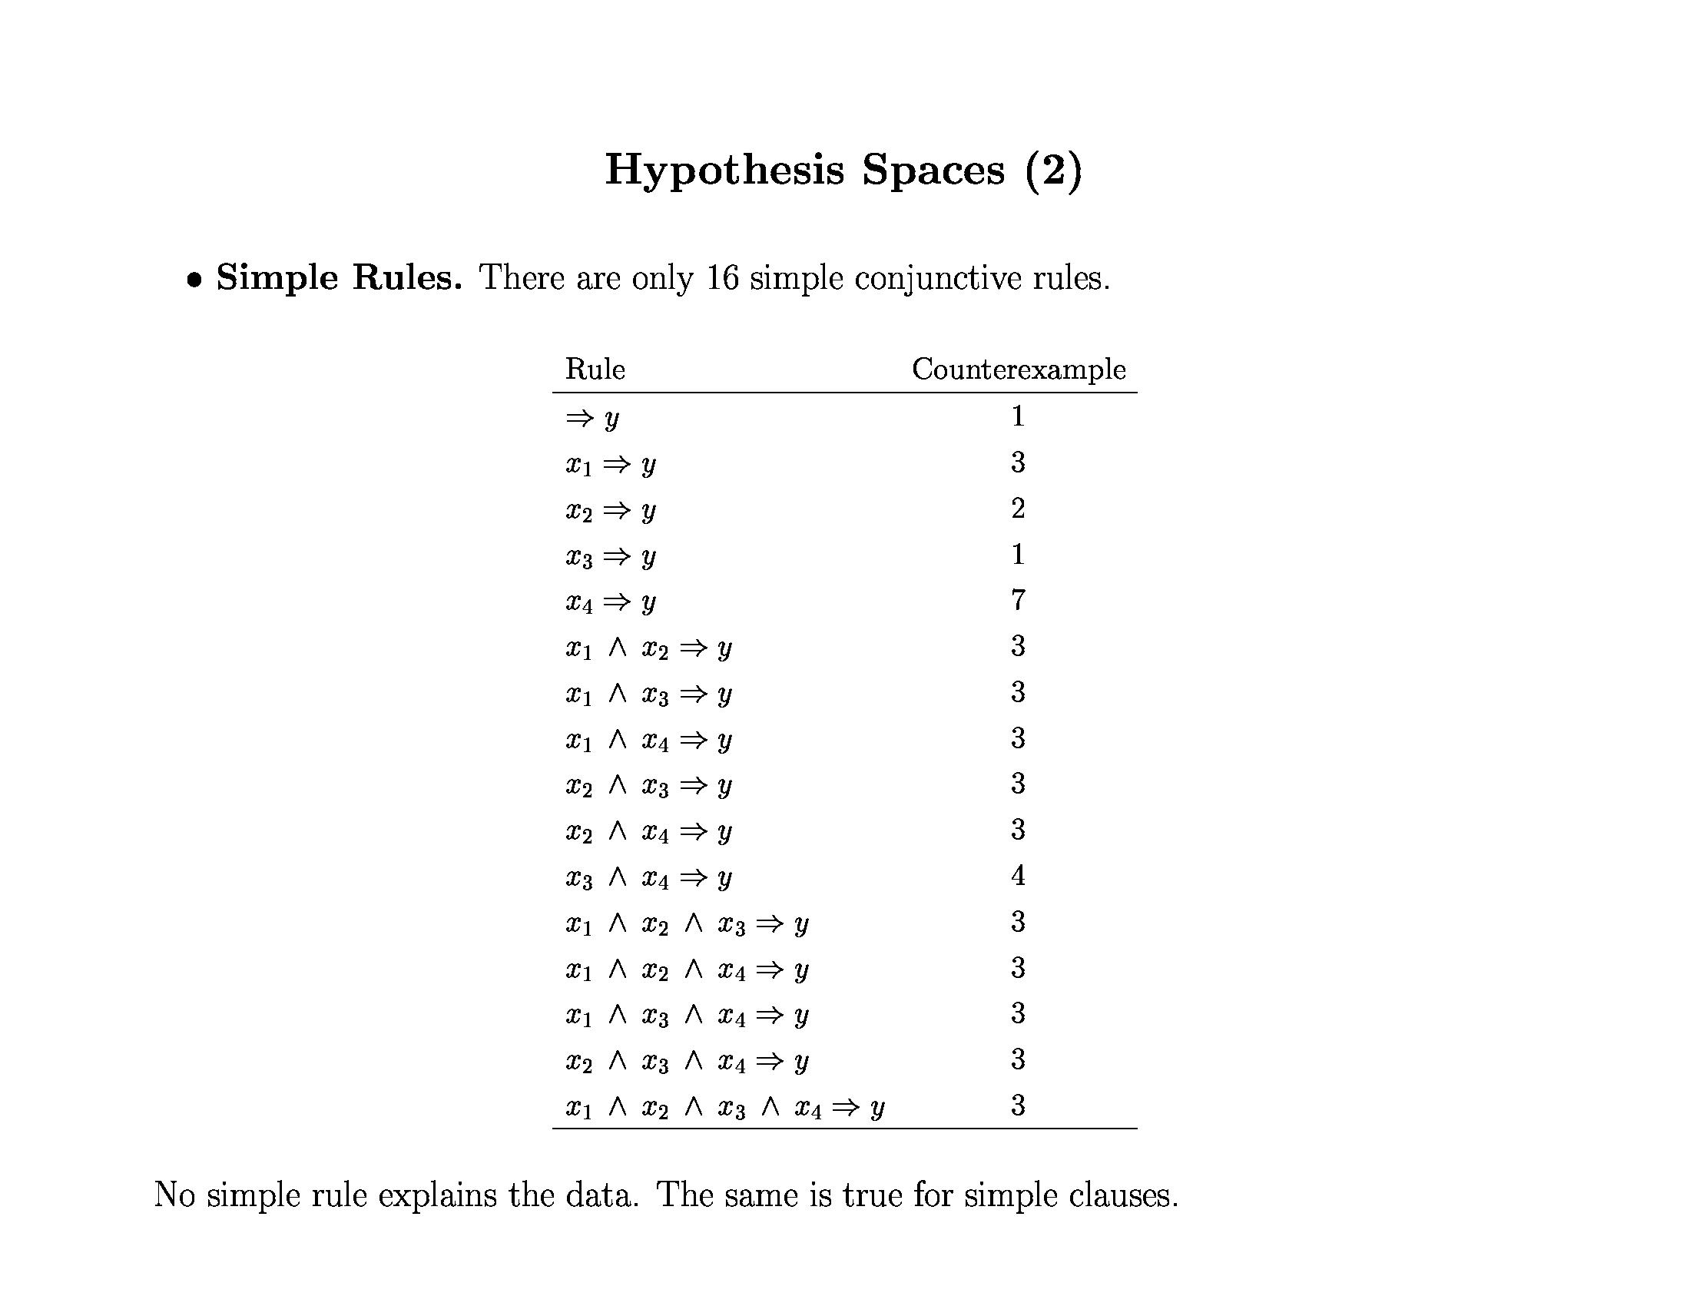
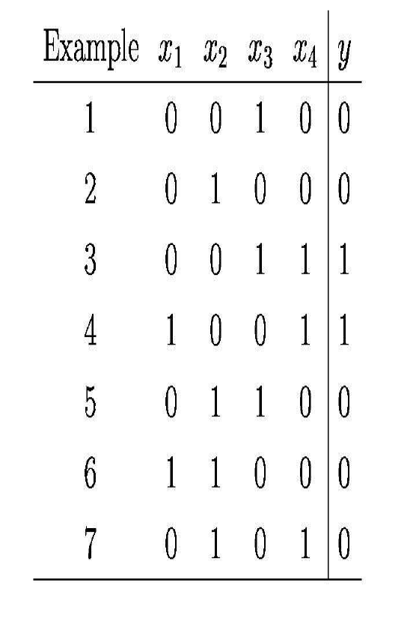

Slide 18
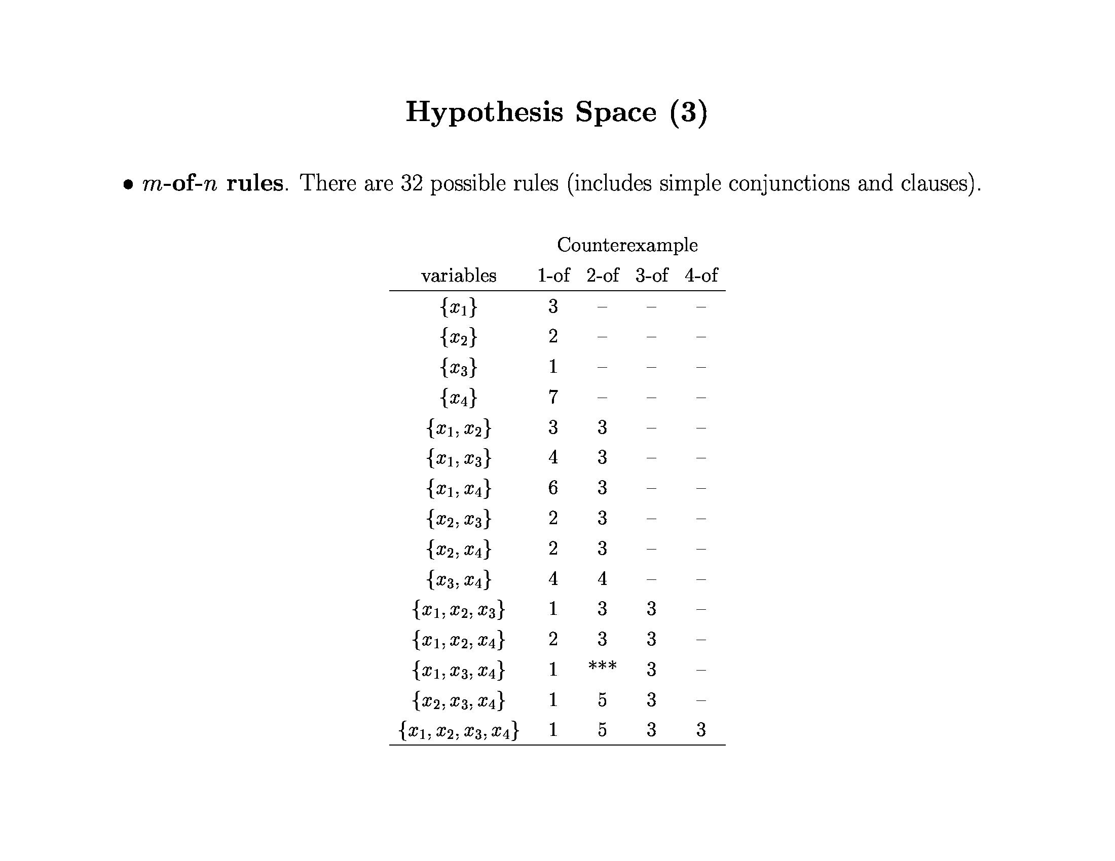
x₁ ⇒ y
x₃ ⇒ y
x₄ ⇒ y

Slide 19
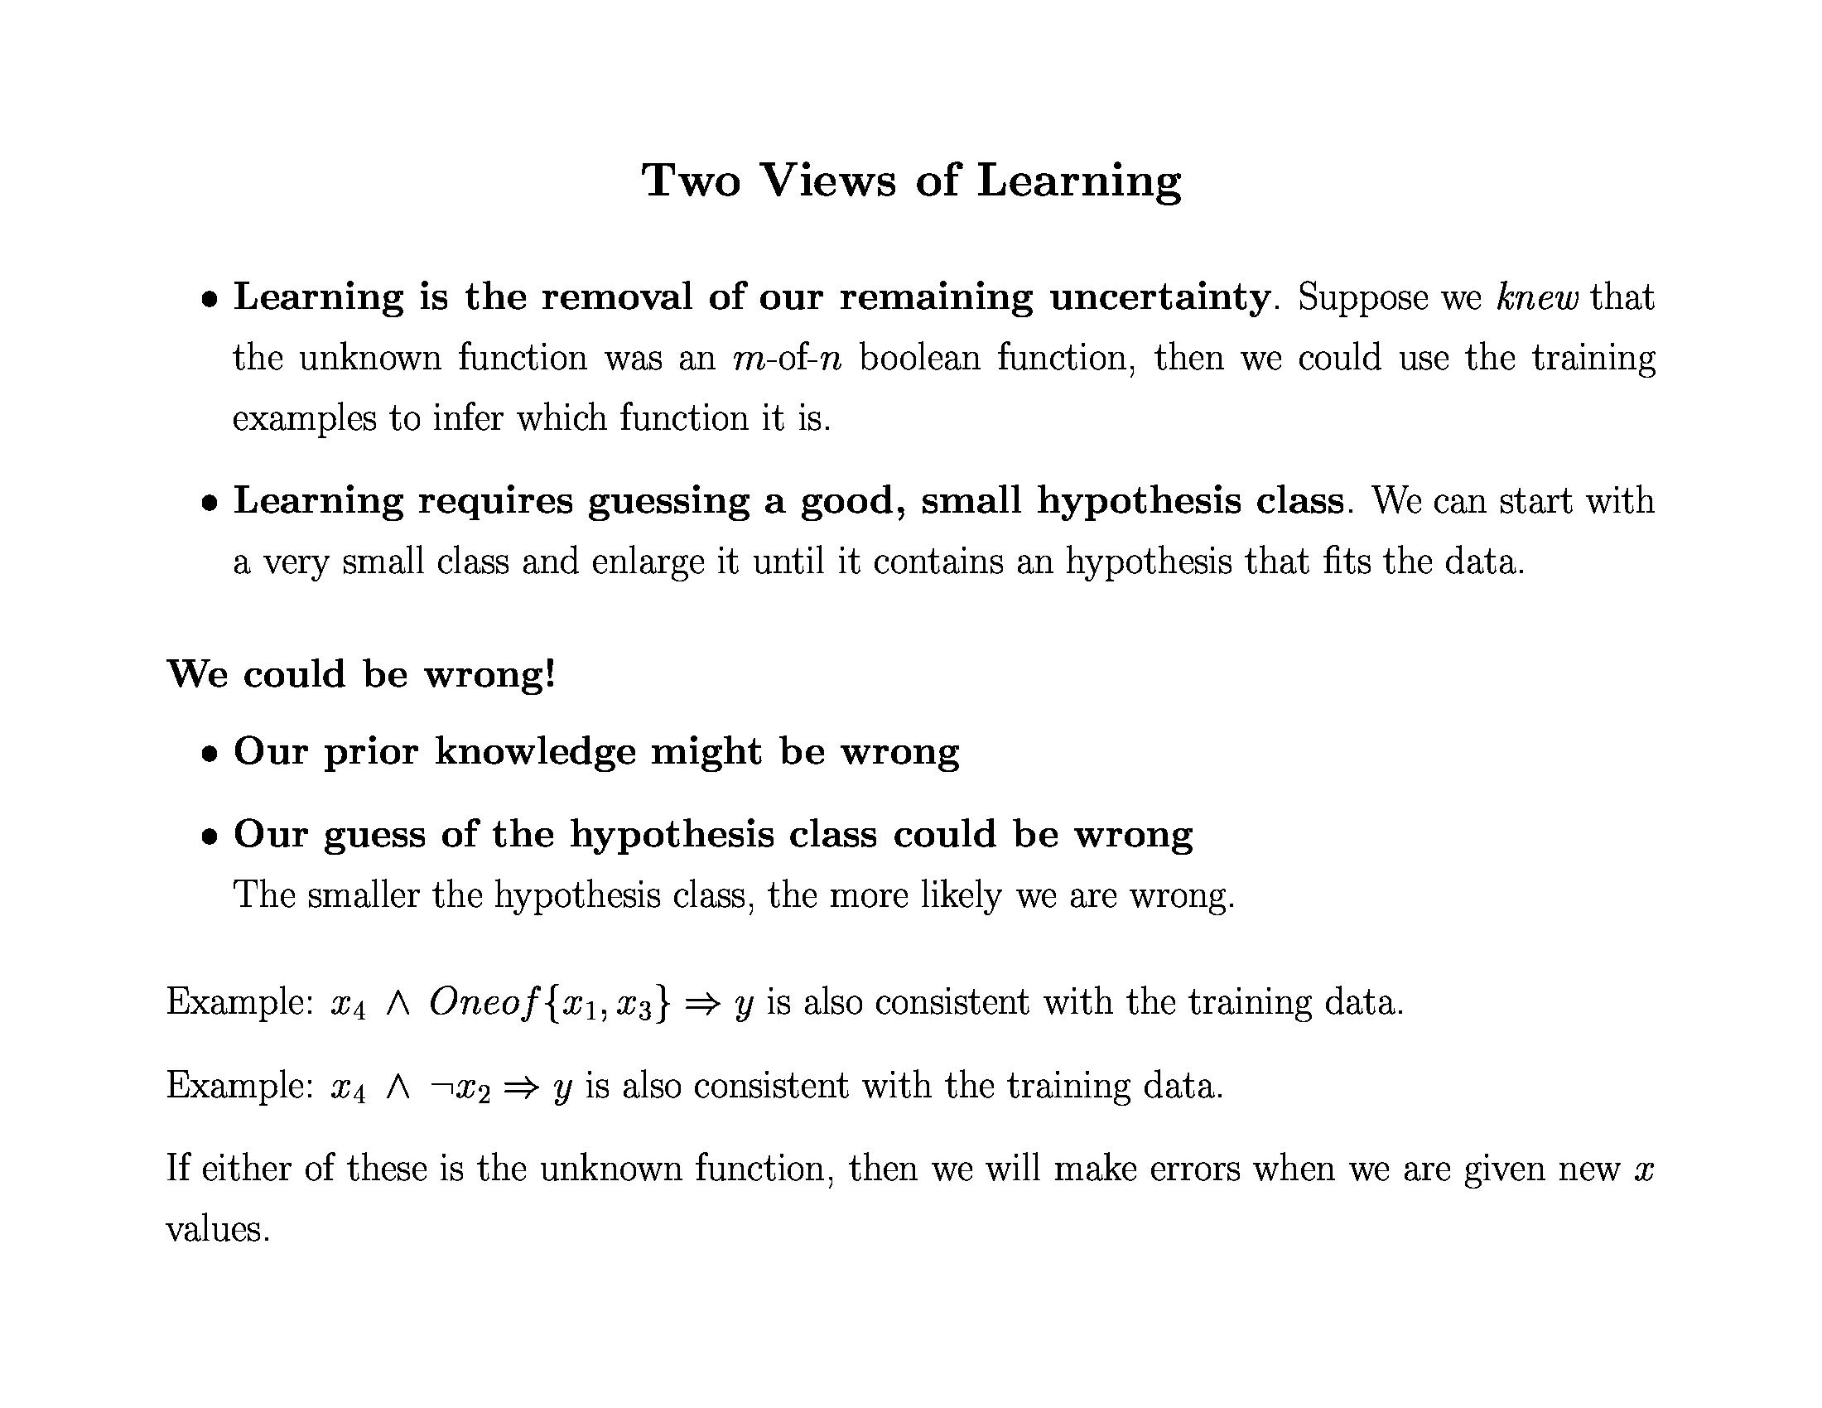

Slide 20
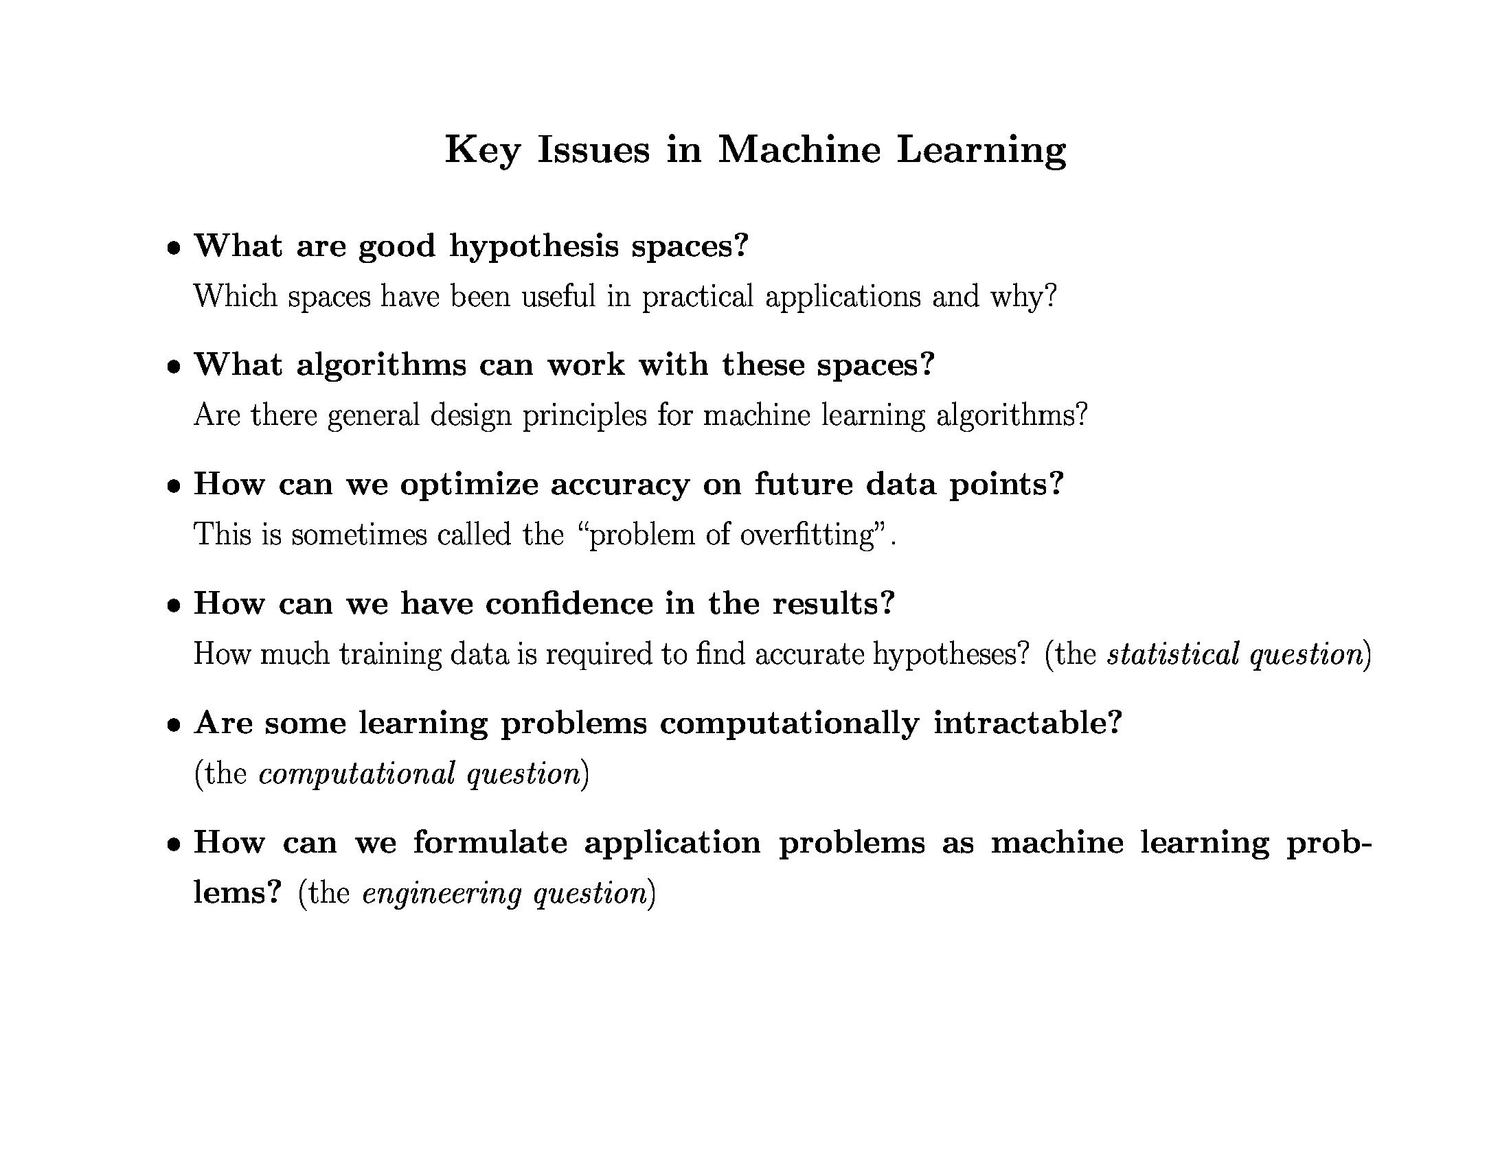

Slide 21
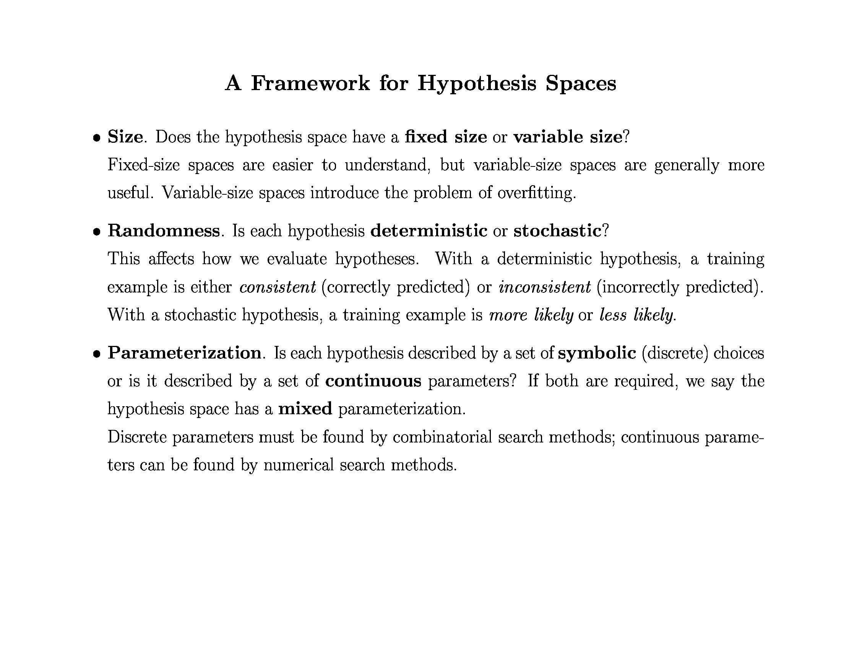

Slide 22
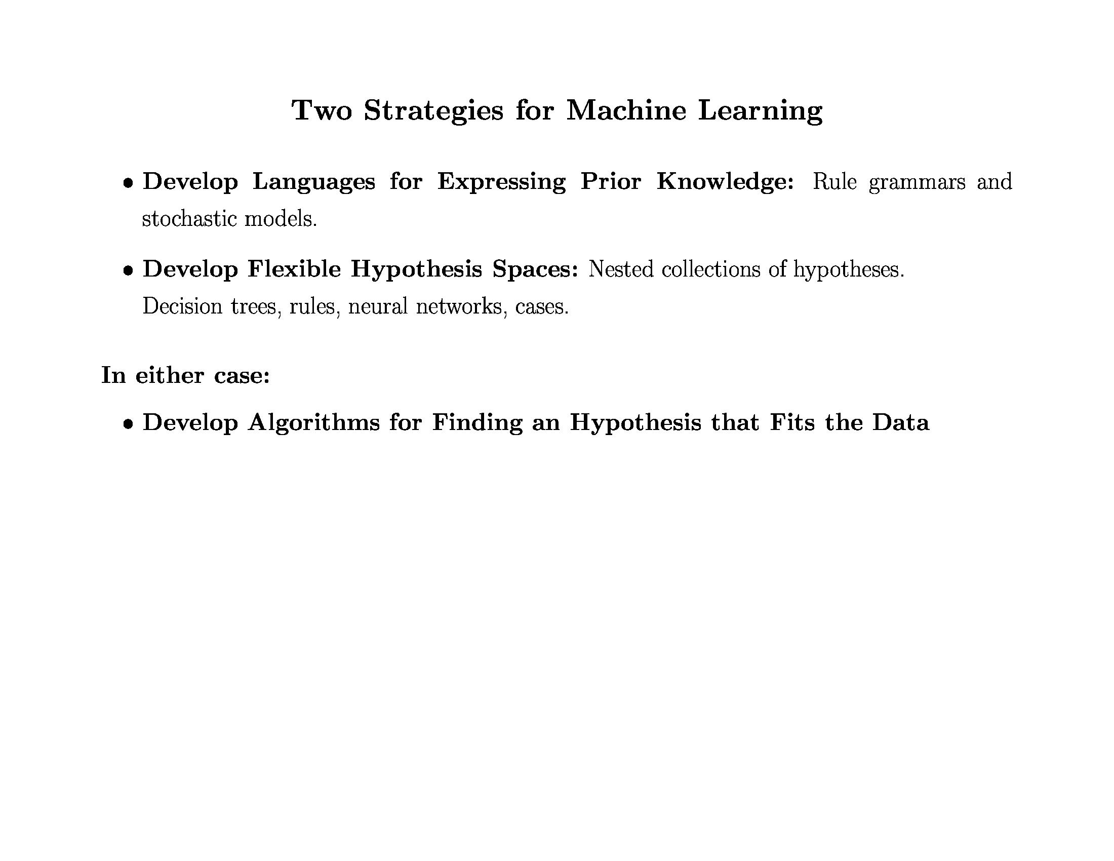

Slide 23
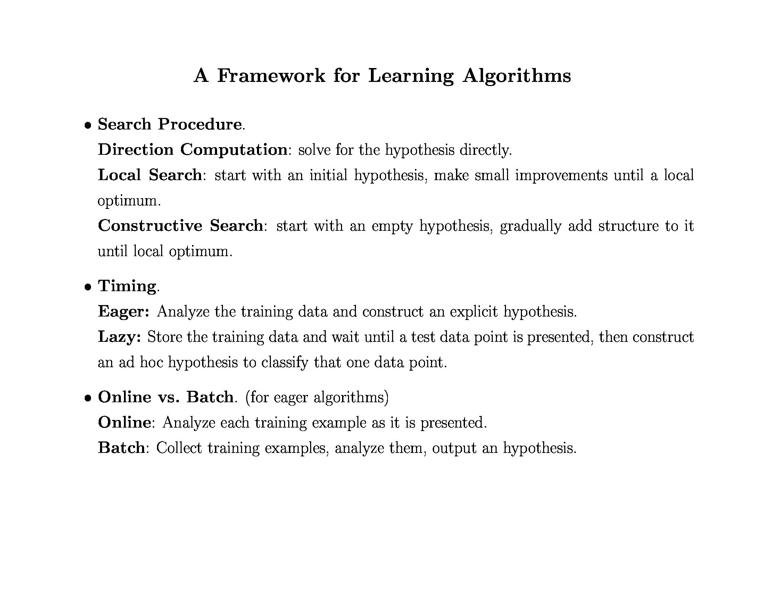

Slide 24
Eager
0.0 1.0 2.0 3.0
+
+
Label: +
+
Label: -
+
-
+
+
-
-
-
-
+
+
-
-
+
-
-
+
-
-
+
+
+
-
-
0.0 1.0 2.0 3.0 4.0 5.0 6.0

Slide 25
Eager
0.0 1.0 2.0 3.0
Label: +
Label: -
?
?
?
?
0.0 1.0 2.0 3.0 4.0 5.0 6.0

Slide 26
Lazy
0.0 1.0 2.0 3.0
+
+
?
+
+
-
+
+
-
-
-
-
+
+
-
?
Label based on neighbors
?
-
+
-
-
+
-
-
+
+
+
-
?
-
0.0 1.0 2.0 3.0 4.0 5.0 6.0

Slide 27
Batch
0.0 1.0 2.0 3.0
0.0 1.0 2.0 3.0 4.0 5.0 6.0

Slide 28
Batch
0.0 1.0 2.0 3.0
+
+
Label: +
+
Label: -
+
-
+
+
-
-
-
-
+
+
-
-
+
-
-
+
-
-
+
+
+
-
-
0.0 1.0 2.0 3.0 4.0 5.0 6.0

Slide 29
Online
0.0 1.0 2.0 3.0
0.0 1.0 2.0 3.0 4.0 5.0 6.0

Slide 30
Online
0.0 1.0 2.0 3.0
+
Label: -
Label: +
-
0.0 1.0 2.0 3.0 4.0 5.0 6.0

Slide 31
Online
0.0 1.0 2.0 3.0
+
Label: -
+
Label: +
-
0.0 1.0 2.0 3.0 4.0 5.0 6.0

Slide 32
Online
0.0 1.0 2.0 3.0
+
+
Label: +
Label: -
-
0.0 1.0 2.0 3.0 4.0 5.0 6.0

Slide 33
Decision Trees
Convenient Representation
Developed with learning in mind
Deterministic
Comprehensible output
Expressive
Equivalent to propositional DNF
Handles discrete and continuous parameters
Simple learning algorithm
Handles noise well
Classify as follows
Constructive (build DT by adding nodes)
Eager
Batch (but incremental versions exist)

Slide 34
Concept Learning
E.g., Learn concept “Edible mushroom”
Target Function has two values: T or F
Represent concepts as decision trees
Use hill climbing search thru space of decision trees
Start with simple concept
Refine it into a complex concept as needed

Slide 35
Example: “Good day for tennis”
Attributes of instances
Outlook = {rainy (r), overcast (o), sunny (s)}
Temperature = {cool (c), medium (m), hot (h)}
Humidity = {normal (n), high (h)}
Wind = {weak (w), strong (s)}
Class value
Play Tennis? = {don’t play (n), play (y)}
Feature = attribute with one value
E.g., outlook = sunny
Sample instance
outlook=sunny, temp=hot, humidity=high, wind=weak

Slide 36
Experience: “Good day for tennis”
Day Outlook Temp Humid Wind PlayTennis?
d1 s h h w n
d2 s h h s n
d3 o h h w y
d4 r m h w y
d5 r c n w y
d6 r c n s n
d7 o c n s y
d8 s m h w n
d9 s c n w y
d10 r m n w y
d11 s m n s y
d12 o m h s y
d13 o h n w y
d14 r m h s n

Slide 37
Decision Tree Representation
Good day for tennis?
Leaves = classification
Arcs = choice of value
for parent attribute
Outlook
Sunny
Rain
Overcast
Humidity
Wind
Play
Strong
Weak
High
Normal
Don’t play
Play
Don’t play
Play
Decision tree is equivalent to logic in disjunctive normal form
Play ⇔ (Sunny ∧ Normal) ∨ Overcast ∨ (Rain ∧ Weak)

Slide 38
Numeric Attributes
Use thresholds to convert numeric attributes into discrete values
Outlook
Sunny
Rain
Overcast
Humidity
Wind
Play
>= 10 MPH
< 10 MPH
>= 75%
< 75%
Don’t play
Play
Don’t play
Play

Slide 39
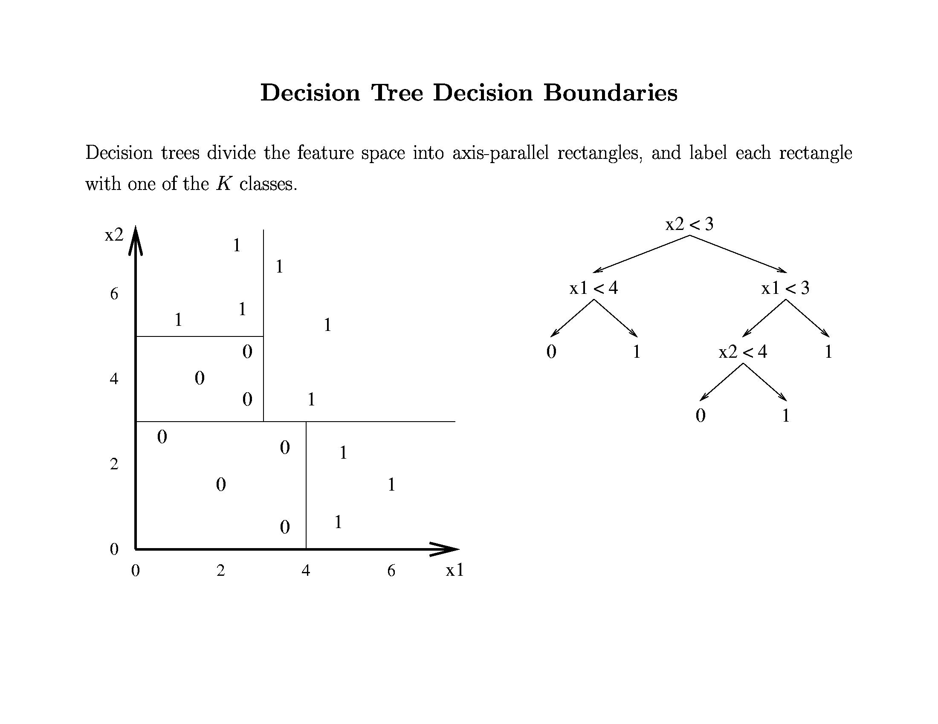

Slide 40
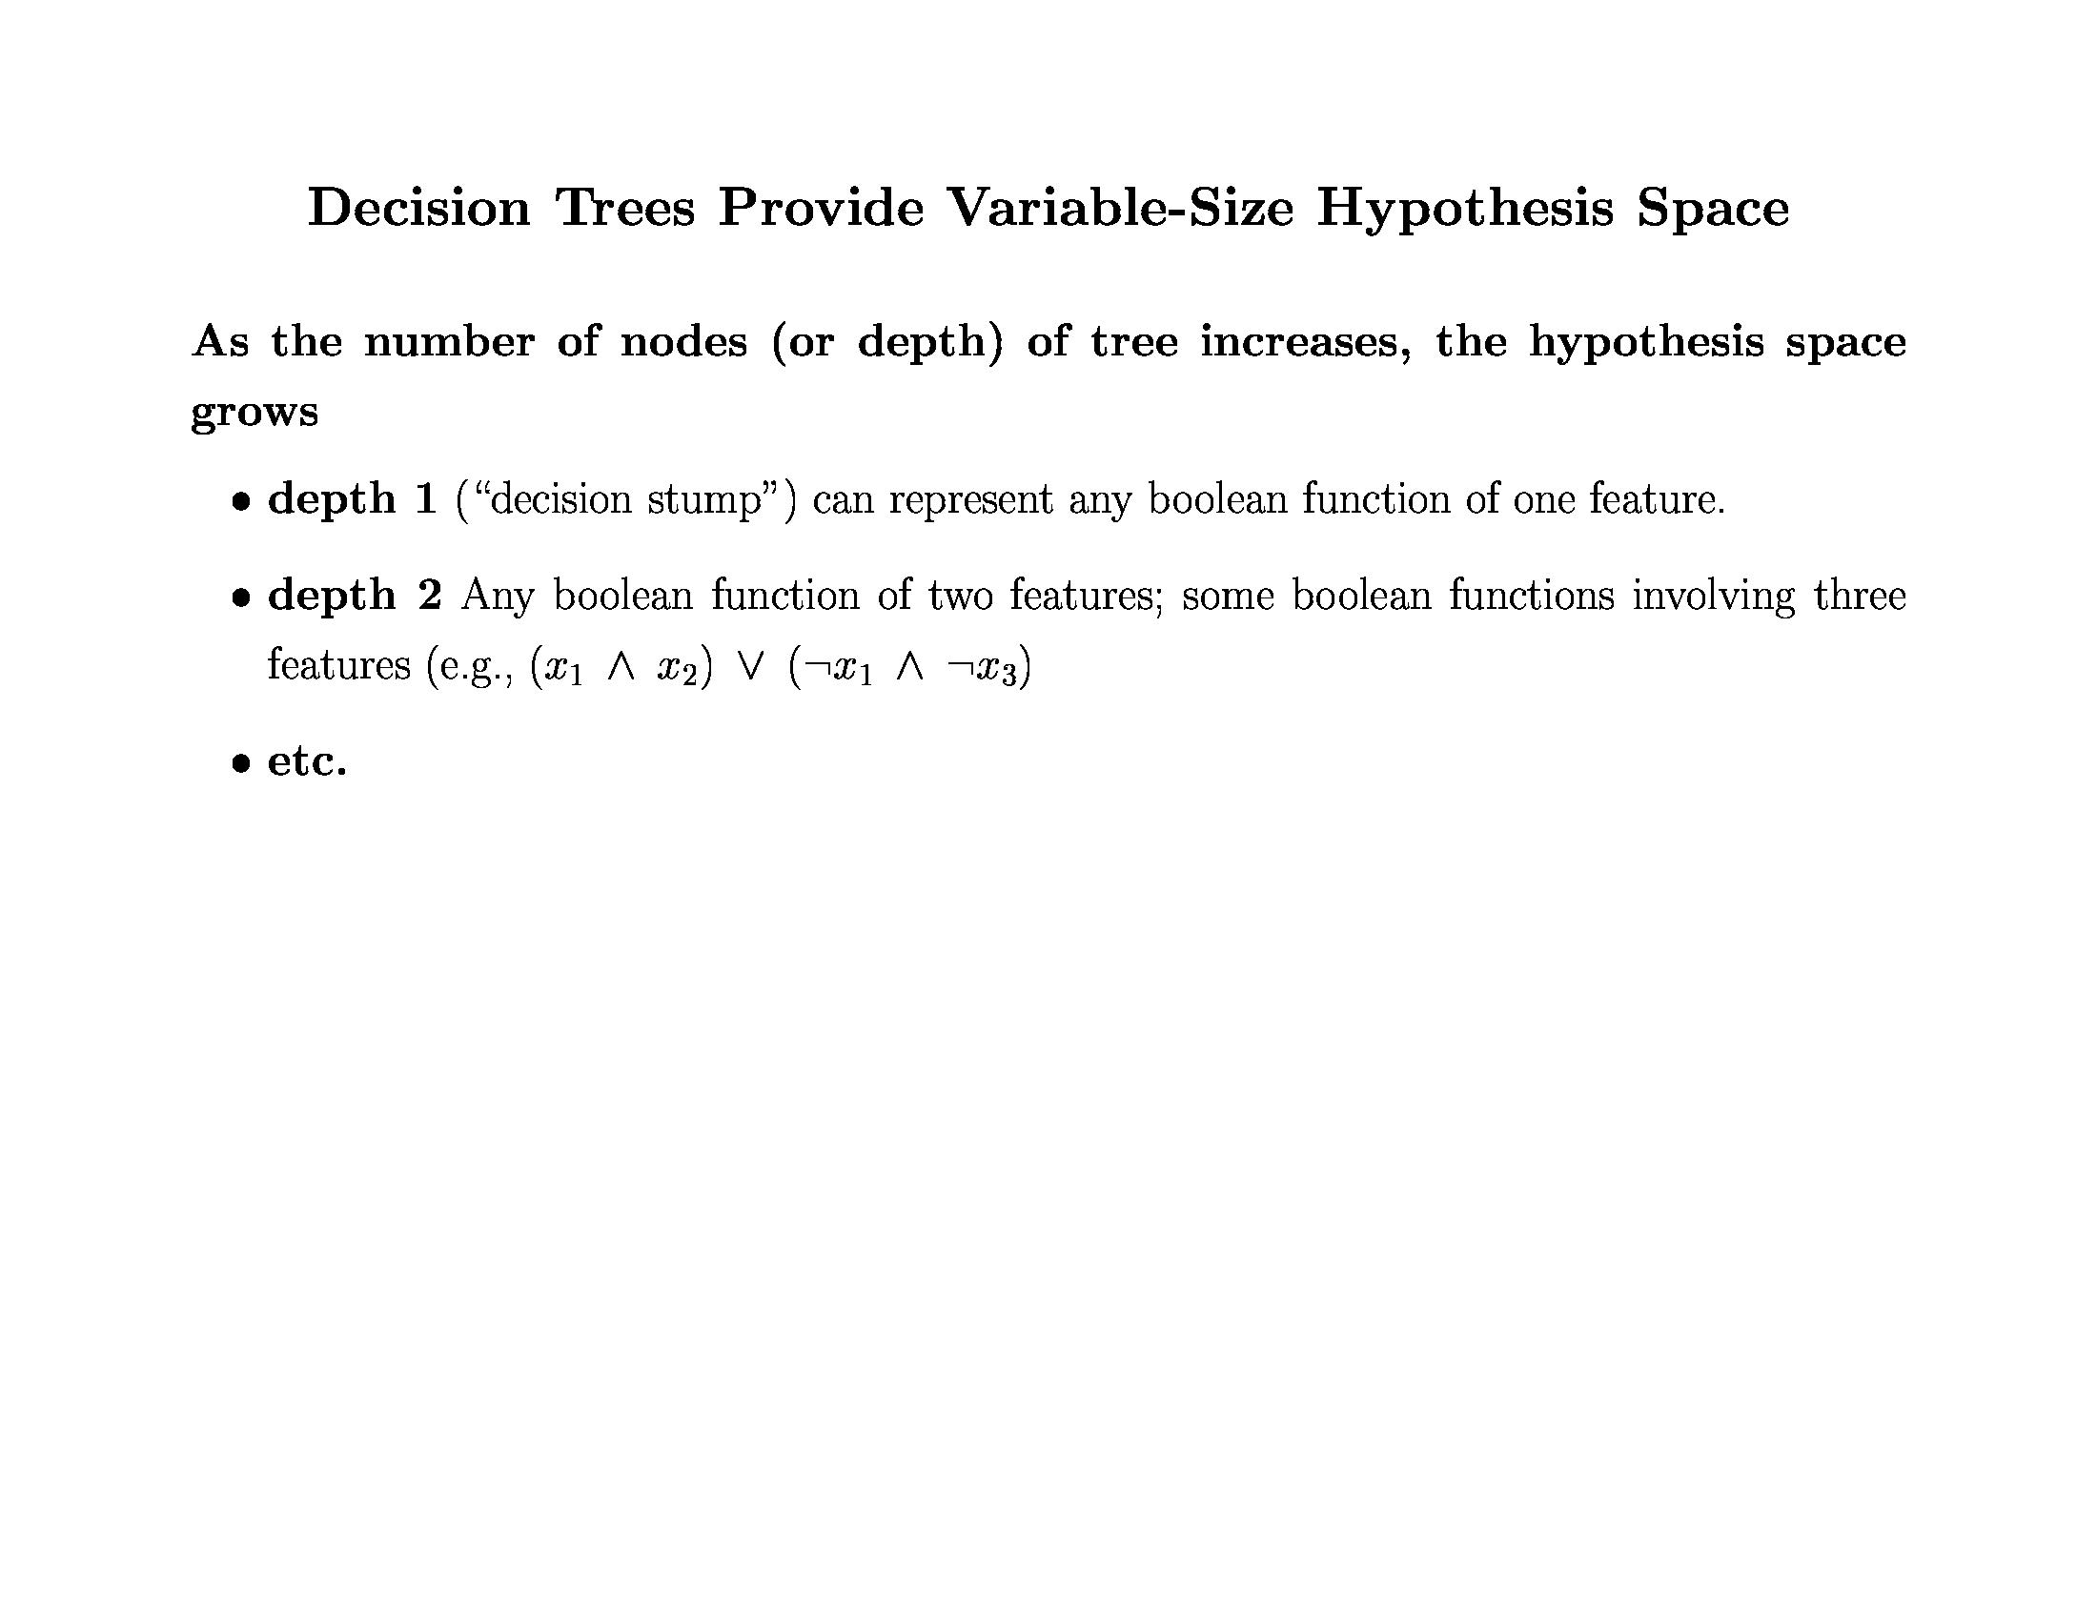

Slide 41
DT Learning as Search
Nodes
Operators
Initial node
Heuristic?
Goal?
Decision Trees
Tree Refinement: Sprouting the tree
Smallest tree possible: a single leaf
Information Gain
Best tree possible (???)

Slide 42
What is the Simplest Tree?
Day Outlook Temp Humid Wind Play?
d1 s h h w n
d2 s h h s n
d3 o h h w y
d4 r m h w y
d5 r c n w y
d6 r c n s n
d7 o c n s y
d8 s m h w n
d9 s c n w y
d10 r m n w y
d11 s m n s y
d12 o m h s y
d13 o h n w y
d14 r m h s n
How good?
Majority class:
correct on 9 examples
incorrect on 5 examples
[9+, 5-]

Slide 43
Successors
Yes
Humid
Wind
Outlook
Temp
Which attribute should we use to split?

Slide 44
Disorder is bad Homogeneity is good
No
Better
Bad
Good

Slide 45
Entropy
50-50 class split
Maximum disorder
1.0
0.5
All positive
Pure distribution
% of example that are positive
.00 .50 1.00

Slide 46
Entropy (disorder) is bad Homogeneity is good
Let S be a set of examples
Entropy(S) = -P log₂(P) - N log₂(N)
P is proportion of pos example
N is proportion of neg examples
0 log 0 == 0
Example: S has 9 pos and 5 neg Entropy([9+, 5-]) = -(9/14) log₂(9/14) - (5/14)log₂(5/14)
= 0.940

Slide 47
Information Gain
Measure of expected reduction in entropy
Resulting from splitting along an attribute
Σ
v ∈ Values(A)
Gain(S,A) = Entropy(S) - (|Sv| / |S|) Entropy(Sv)
Where Entropy(S) = -P log₂(P) - N log₂(N)

Slide 48
Gain of Splitting on Wind
Values(wind)=weak, strong
S = [9+, 5-]
Day Wind Tennis?
d1 weak n
d2 s n
d3 weak yes
d4 weak yes
d5 weak yes
d6 s n
d7 s yes
d8 weak n
d9 weak yes
d10 weak yes
d11 s yes
d12 s yes
d13 weak yes
d14 s n
S_{weak} = [6+, 2-]
S_{s} = [3+, 3-]
Gain(S, wind)
= Entropy(S) - (|S_{v}| / |S|) Entropy(S_{v})
= Entropy(S) - 8/14 Entropy(S_{weak})
- 6/14 Entropy(S_{s})
= 0.940 - (8/14) 0.811 - (6/14) 1.00
= .048
Σ
v ∈ {weak, s}

Slide 49
Decision Tree Algorithm
BuildTree(TraingData)
Split(TrainingData)
Split(D)
If (all points in D are of the same class)
Then Return
For each attribute A
Evaluate splits on attribute A
Use best split to partition D into D1, D2
Split (D1)
Split (D2)

Slide 50
Evaluating Attributes
Yes
Humid
Wind
Gain(S,Wind)
=0.048
Gain(S,Humid)
=0.151
Outlook
Temp
Gain(S,Outlook)
=0.246
Gain(S,Temp)
=0.029

Slide 51
Resulting Tree
Good day for tennis?
Outlook
Sunny
Rain
Overcast
Don’t Play
[2+, 3-]
Don’t Play
[3+, 2-]
Play
[4+]

Slide 52
Recurse
Good day for tennis?
Outlook
Sunny
Rain
Overcast
Day Temp Humid Wind Tennis?
d1 h h weak n
d2 h h s n
d8 m h weak n
d9 c n weak yes
d11 m n s yes

Slide 53
One Step Later
Good day for tennis?
Outlook
Sunny
Rain
Overcast
Humidity
Don’t Play
[2+, 3-]
Play
[4+]
High
Normal
Don’t play
[3-]
Play
[2+]

Slide 54
Recurse Again
Good day for tennis?
Outlook
Sunny
Medium
Overcast
Humidity
Day Temp Humid Wind Tennis?
d4 m h weak yes
d5 c n weak yes
d6 c n s n
d10 m n weak yes
d14 m h s n
High
Low

Slide 55
One Step Later: Final Tree
Good day for tennis?
Outlook
Sunny
Rain
Overcast
Humidity
Wind
Play
[4+]
Strong
Weak
High
Normal
Don’t play
[2-]
Play
[3+]
Don’t play
[3-]
Play
[2+]

Slide 56
Issues
Missing data
Real-valued attributes
Many-valued features
Evaluation
Overfitting

Slide 57
Missing Data 1
Day Temp Humid Wind Tennis?
d1 h h weak n
d2 h h s n
d8 m h weak n
d9 c ? weak yes
d11 m n s yes
Assign most common value at this node
?=>h
Day Temp Humid Wind Tennis?
d1 h h weak n
d2 h h s n
d8 m h weak n
d9 c ? weak yes
d11 m n s yes
Assign most common value for class
?=>n

Slide 58
Missing Data 2
[0.75+, 3-]
Day Temp Humid Wind Tennis?
d1 h h weak n
d2 h h s n
d8 m h weak n
d9 c ? weak yes
d11 m n s yes
[1.25+, 0-]
75% h and 25% n
Use in gain calculations
Further subdivide if other missing attributes
Same approach to classify test ex with missing attr
Classification is most probable classification
Summing over leaves where it got divided

Slide 59
Real-valued Features
Discretize?
Threshold split using observed values?
8
n
25
n
7
y
6
y
6
y
10
n
12
y
5
n
7
y
7
y
12
y
10
y
7
y
11
n
Wind
Play
25
n
Wind
Play
12
y
12
y
11
n
10
y
10
n
8
n
7
y
7
y
7
y
7
y
6
y
6
y
5
n
>= 12
Gain = 0.0004
>= 10
Gain = 0.048

Slide 60
Many-valued Attributes
Problem:
If attribute has many values, Gain will select it
Imagine using Date = June_6_1996
So many values
Divides examples into tiny sets
Sets are likely uniform => high info gain
Poor predictor
Penalize these attributes

Slide 61
One Solution: Gain Ratio
Gain Ratio(S,A) = Gain(S,A)/SplitInfo(S,A)
SplitInfo = (|Sv| / |S|) Log2(|Sv|/|S|)
Σ
v ∈ Values(A)
SplitInfo ≅ entropy of S wrt values of A
(Contrast with entropy of S wrt target value)
attribs with many uniformly distrib values
e.g. if A splits S uniformly into n sets
SplitInformation = log₂(n)… = 1 for Boolean

Slide 62
Evaluation: Cross Validation
Partition examples into k disjoint sets
Now create k training sets
Each set is union of all equiv classes except one
So each set has (k-1)/k of the original training data
← Train →
Test
Test
Test

Slide 63
Cross-Validation (2)
Leave-one-out
Use if < 100 examples (rough estimate)
Hold out one example, train on remaining examples
M of N fold
Repeat M times
Divide data into N folds, do N fold cross-validation

Slide 64
Methodology Citations
Dietterich, T. G., (1998). Approximate Statistical Tests for Comparing Supervised Classification Learning Algorithms. Neural Computation, 10 (7) 1895-1924
Densar, J., (2006). Demsar, Statistical Comparisons of Classifiers over Multiple Data Sets. The Journal of Machine Learning Research, pages 1-30.

Slide 65
Overfitting
On training data
On test data
Accuracy
0.9
0.8
0.7
0.6
Number of Nodes in Decision tree

Slide 66
Overfitting Definition
DT is overfit when exists another DT’ and
DT has smaller error on training examples, but
DT has bigger error on test examples
Causes of overfitting
Noisy data, or
Training set is too small
Solutions
Reduced error pruning
Early stopping
Rule post pruning

Slide 67
Reduced Error Pruning
Split data into train and validation set
Repeat until pruning is harmful
Remove each subtree and replace it with majority class and evaluate on validation set
Remove subtree that leads to largest gain in accuracy
Test
Tune
Tune
Tune

Slide 68
Reduced Error Pruning Example
Outlook
Sunny
Rain
Overcast
Humidity
Wind
Play
Strong
Weak
High
Low
Don’t play
Play
Don’t play
Play
Validation set accuracy = 0.75

Slide 69
Reduced Error Pruning Example
Outlook
Sunny
Rain
Overcast
Don’t play
Wind
Play
Strong
Weak
Don’t play
Play
Validation set accuracy = 0.80

Slide 70
Reduced Error Pruning Example
Outlook
Sunny
Rain
Overcast
Humidity
Play
Play
High
Low
Don’t play
Play
Validation set accuracy = 0.70

Slide 71
Reduced Error Pruning Example
Outlook
Sunny
Rain
Overcast
Don’t play
Wind
Play
Strong
Weak
Don’t play
Play
Use this as final tree

Slide 72
Early Stopping
On training data
On test data
On validation data
Accuracy
Remember this tree and use it as the final classifier
0.9
0.8
0.7
0.6
Number of Nodes in Decision tree

Slide 73
Post Rule Pruning
Split data into train and validation set
Prune each rule independently
Remove each pre-condition and evaluate accuracy
Pick pre-condition that leads to largest improvement in accuracy
Note: ways to do this using training data and statistical tests

Slide 74
Conversion to Rule
Outlook
Sunny
Rain
Overcast
Humidity
Wind
Play
Strong
Weak
High
Low
Don’t play
Play
Don’t play
Play
Outlook = Sunny ∧ Humidity = High ⇒ Don’t play
Outlook = Sunny ∧ Humidity = Low ⇒ Play
Outlook = Overcast ⇒ Play
…

Slide 75
Example
Outlook = Sunny ∧ Humidity = High ⇒ Don’t play
Validation set accuracy = 0.68
Outlook = Sunny ⇒ Don’t play
Validation set accuracy = 0.65
Humidity = High ⇒ Don’t play
Validation set accuracy = 0.75
Keep this rule

Slide 76
Summary
Overview of inductive learning
Hypothesis spaces
Inductive bias
Components of a learning algorithm
Decision trees
Algorithm for constructing trees
Issues (e.g., real-valued data, overfitting)

Slide 77
Gain of Split on Humidity
Day Outlook Temp Humid Wind Play?
d1 s h h w n
d2 s h h s n
d3 o h h w y
d4 r m h w y
d5 r c n w y
d6 r c n s n
d7 o c n s y
d8 s m h w n
d9 s c n w y
d10 r m n w y
d11 s m n s y
d12 o m h s y
d13 o h n w y
d14 r m h s n
Entropy([9+,5-]) = 0.940
Entropy([4+,3-]) = 0.985
Entropy([6+,-1]) = 0.592
Gain = 0.940- 0.985/2 - 0.592/2= 0.151

Slide 78
Gain of Split on Humidity
Day Outlook Temp Humid Wind Play?
d1 s h h w n
d2 s h h s n
d3 o h h w y
d4 r m h w y
d5 r c n w y
d6 r c n s n
d7 o c n s y
d8 s m h w n
d9 s c n w y
d10 r m n w y
d11 s m n s y
d12 o m h s y
d13 o h n w y
d14 r m h s n
Gain(S,A) = Entropy(S) - (|Sv| / |S|) Entropy(Sv)
Where Entropy(S) = -P log₂(P) - N log₂(N)
Σ
v ∈ Values(A)

Slide 79
Is…
Entropy([4+,3-]) = .985
Entropy([6+,-1]) = .592
Gain = 0.940- .985/2 - .592/2= 0.151

Slide 80
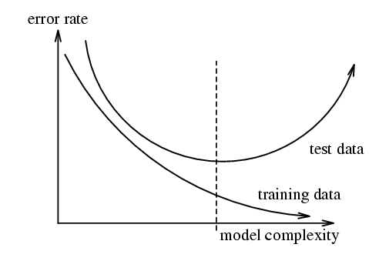
Overfitting 2
Figure from w.w.cohen

Slide 81
Choosing the Training Experience
Credit assignment problem:
Direct training examples:
E.g. individual checker boards + correct move for each
Supervised learning
Indirect training examples :
E.g. complete sequence of moves and final result
Reinforcement learning
Which examples:
Random, teacher chooses, learner chooses

Slide 82
Example: Checkers
Task T:
Playing checkers
Performance Measure P:
Percent of games won against opponents
Experience E:
Playing practice games against itself
Target Function
V: board -> R
Representation of approx. of target function
V(b) = a + bx1 + cx2 + dx3 + ex4 + fx5 + gx6

Slide 83
Choosing the Target Function
What type of knowledge will be learned?
How will the knowledge be used by the performance program?
E.g. checkers program
Assume it knows legal moves
Needs to choose best move
So learn function: F: Boards -> Moves
hard to learn
Alternative: F: Boards -> R
Note similarity to choice of problem space

Slide 84
The Ideal Evaluation Function
V(b) = 100 if b is a final, won board
V(b) = -100 if b is a final, lost board
V(b) = 0 if b is a final, drawn board
Otherwise, if b is not final
V(b) = V(s) where s is best, reachable final board
Nonoperational…
Want operational approximation of V: V

Slide 85
How Represent Target Function
x₁ = number of black pieces on the board
x₂ = number of red pieces on the board
x₃ = number of black kings on the board
x₄ = number of red kings on the board
x₅ = num of black pieces threatened by red
x₆ = num of red pieces threatened by black
V(b) = a + bx₁ + cx₂ + dx₃ + ex₄ + fx₅ + gx₆
Now just need to learn 7 numbers!

Slide 86
Target Function
Profound Formulation:
Can express any type of inductive learning as approximating a function
E.g., Checkers
V: boards -> evaluation
E.g., Handwriting recognition
V: image -> word
E.g., Mushrooms
V: mushroom-attributes -> {E, P}

Slide 87
Choosing the Training Experience
Credit assignment problem:
Direct training examples:
E.g. individual checker boards + correct move for each
Supervised learning
Indirect training examples :
E.g. complete sequence of moves and final result
Reinforcement learning
Which examples:
Random, teacher chooses, learner chooses

Slide 88
A Framework for Learning Algorithms
Search procedure
Direction computation: Solve for hypothesis directly
Local search: Start with an initial hypothesis on make local refinements
Constructive search: start with empty hypothesis and add constraints
Timing
Eager: Analyze data and construct explicit hypothesis
Lazy: Store data and construct ad-hoc hypothesis to classify data
Online vs. batch
Online
Batch

